Slide 1


Airport Management Project
The Problem:
We focus on the airlines that have contracted with us and the flights operated by those airlines.
We also pay attention to the different weather conditions that
will affect the condition of the plane,
and we also pay attention to the employees
who will be present on each flight,
as well as the maintenance work for the planes and buses.

Slide 2




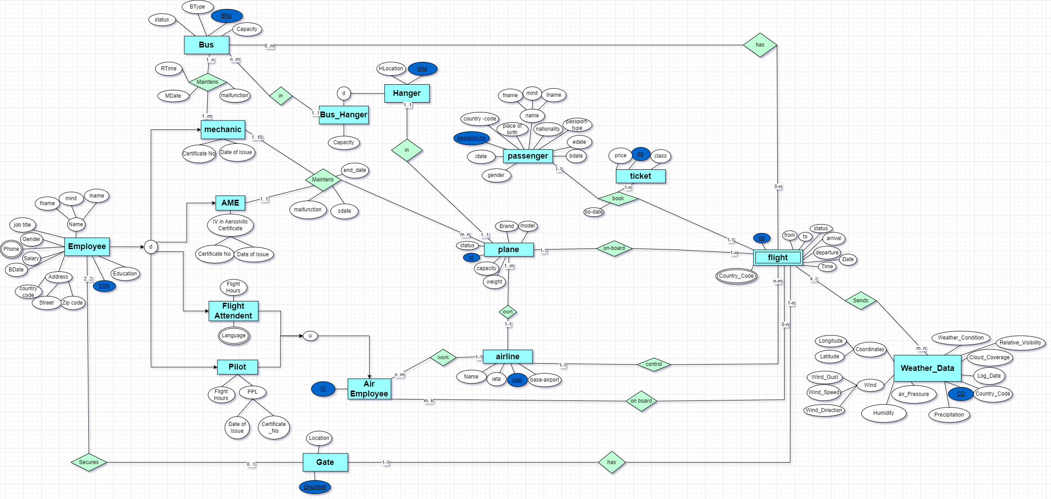
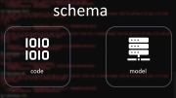
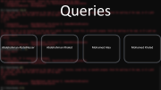

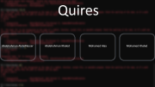
EER
RELATINAL MODEL
Schema
queries
Airport Management Project
The Problem:
We focus on the airlines that have contracted with us and the flights operated by those airlines.
We also pay attention to the different weather conditions that
will affect the condition of the plane,
and we also pay attention to the employees
who will be present on each flight,
as well as the maintenance work for the planes and buses.

Slide 3
Many thanks

Slide 4
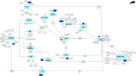

EER
RELATINAL MODEL
Schema
quires

Slide 5
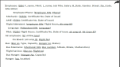
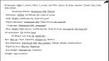
RELATINAL MODEL
EER
Schema
quires

Slide 6
Schema
EER
RELATINAL MODEL
quires

Slide 7
queries
EER
RELATINAL MODEL
Schema
Airport Management Project
The Problem:
We focus on the airlines that have contracted with us and the flights operated by those airlines.
We also pay attention to the different weather conditions that
will affect the condition of the plane,
and we also pay attention to the employees
who will be present on each flight,
as well as the maintenance work for the planes and buses.

Slide 8



Slide 9
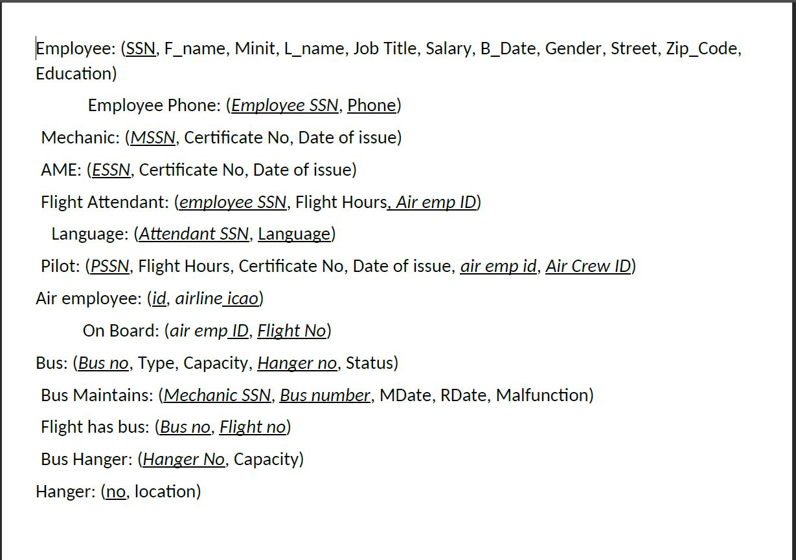

Slide 10
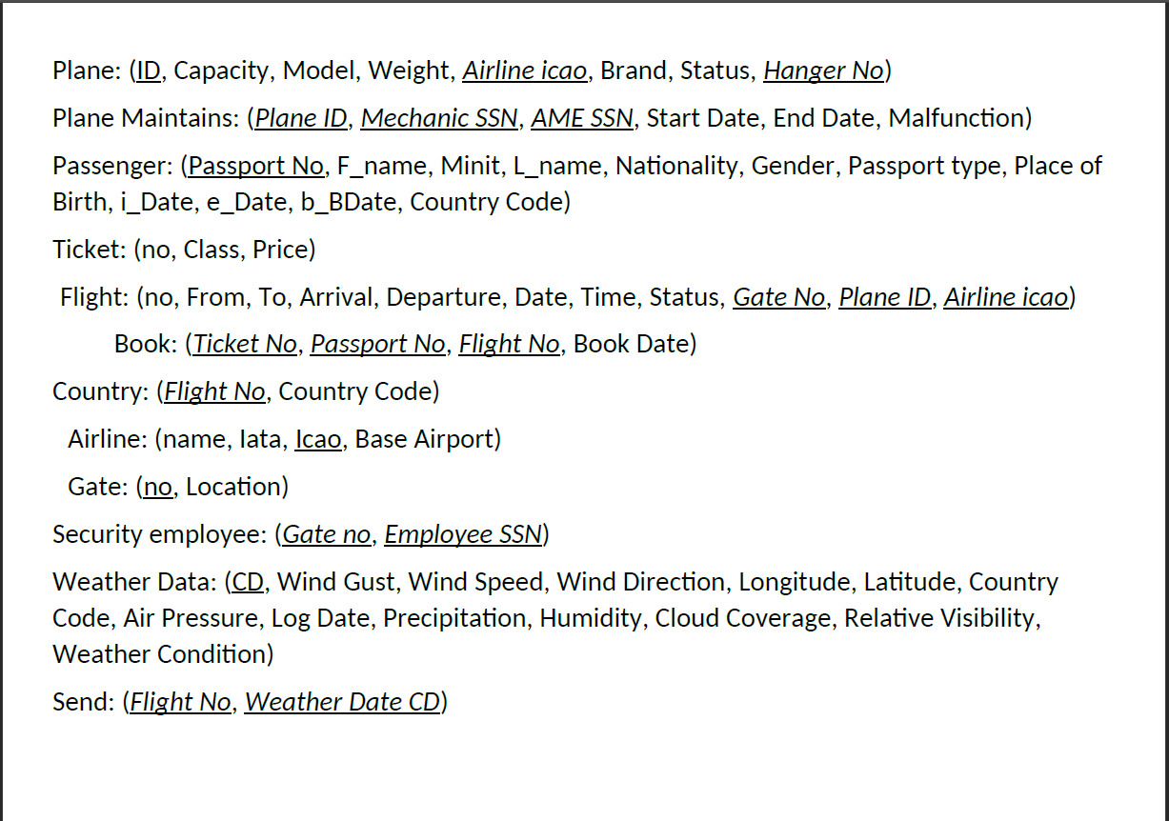

Slide 11
Queries
Abdelrahman AbdelNasser
Abdelrahman Khaled
Mohamed Alaa
Mohamed Khaled

Slide 12


schema
code
model

